Slide 1


Java SL KK - RLL Group 5
Project : Employee Payroll Management

Slide 2


Group 5 : Team members
Group | Id | Name
5 | 2562988 | Prabhakaran S
5 | 2563565 | Sonali Yadav
5 | 2563277 | Varshitha BS
5 | 2563572 | Chandini Tirupathi Mamidwar
5 | 2562908 | Krishna Vamsi Mosalikanti
5 | 2563293 | Mansi Pandey
5 | 2563312 | Vasanth X
5 | 2564360 | Girish Kishor Waykole
5 | 2563582 | Marampudi Narasimha Raju
5 | 2563392 | Naveen B

Slide 3

Contents :
Introduction
Objectives
System requirements
Tools and Technologies
Working of project
Conclusion

Slide 4
Introduction
Employee payroll management system is an Internet-based Java application that automates the working of a company or work center that manage and maintain records of the employees
leaves, work,
attendance and
salary.
It is a software solution that automates the process of calculating and distributing employee paychecks.

Slide 5

Objective
The Primary objective of the design is to deliver the requirement as delivered by the feasibility report. There are some objective we kept in mind.
Practically : The system is quite stable and can be operated by the Employees with average intelligence.
Efficiency : We tried to improve accuracy and productivity.

Slide 6
Employee payroll management is the process of calculating and distributing wages to employees. It involves managing various aspects such as time tracking, payroll processing, tax deductions, and compliance. Effective payroll management ensures accurate and timely payment to employees, reducing errors and improving employee satisfaction.

Slide 7
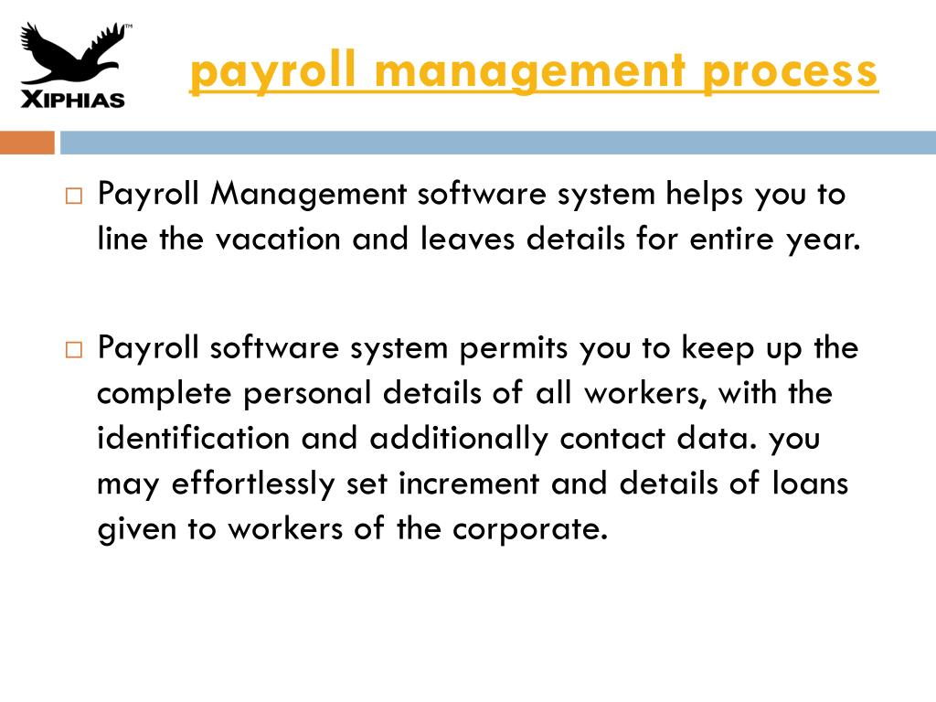

Slide 8
Tools & Languages
Server-side: Spring Boot, Spring Cloud, Spring Data JPA
Database: MySQL
Server: Embedded Tomcat
DevOps: Docker, Git Hub
Spring Cloud: Spring Cloud config, spring cloud Netflix Eureka, Feign, Resilience4j, Retry, Sleuth and Zipkin

Slide 9
Spring cloud:
Spring cloud config:
Spring Cloud Config Server is a central hub for managing configuration properties for distributed applications and microservices.
Spring Cloud Config Server integrates with version control systems like Git and provides a versioned history of configuration changes.
Spring Cloud Config Server offers security features to protect sensitive configuration data, including authentication and authorization mechanisms.
Config Server can be deployed in a high availability configuration to ensure resilience and availability.

Slide 10
Spring Cloud – Netflix Eureka:
Eureka is the Netflix Service Discovery Server and Client.
Eureka is a service registry and discovery server that allows microservices to register themselves and discover other services within the same system.
The server can be configured and deployed to be highly functional, with each server copying the state of the registered services to the others.
Eureka enables client-side load balancing, allowing services to locate and call other services without knowing their exact locations, improving system scalability.

Slide 11
Spring Feign:
Declarative API Requests: Feign simplifies HTTP requests by defining them as Java interfaces with annotated methods.
•Integration with Service Discovery: Feign can seamlessly integrate with service discovery tools like Eureka or Consul.
•Load Balancing: It works with load balancing solutions (e.g., Ribbon) to evenly distribute requests among service instances.
•Fallback and Error Handling: Feign provides mechanisms for handling errors and defining fallback methods for graceful degradation in case of service failures.

Slide 12
Resilience 4J:
Resilience4j is a lightweight fault tolerance library that provides a variety of fault tolerance and stability patterns to a web application.
Resilience4j provides higher-order functions (decorators) to enhance any functional interface, lambda expression or method reference with a Circuit Breaker, Rate Limiter, Retry or Bulkhead.
With Resilience4j you don't have to go all-in, you can pick what you need.
Resilience4j provides several core modules and add-on modules

Slide 13
Spring Retry:
•Automated Retry: Resilience4j's Retry module automates retries for handling transient failures in microservices.
•Declarative or Programmatic: Retry behavior can be configured declaratively with annotations or programmatically in code.
•Exponential Backoff: It supports strategies like exponential backoff to reduce the load on failing services.
•Customizable Control: Highly customizable with options for defining retry count, intervals, and conditions for precise control over retry logic in microservices.

Slide 14
Sleuth:
•Distributed Tracing: Sleuth is a Java library for distributed tracing that helps monitor and analyze requests as they traverse through microservices.
•Integration with Spring Cloud: It seamlessly integrates with Spring Cloud, making it easy to implement distributed tracing in Spring Boot-based microservices.
•Unique Trace IDs: Sleuth generates and propagates unique trace and span IDs, allowing you to trace requests across multiple microservices and gather insights into performance bottlenecks.
•Visualization and Analysis: The collected trace data can be visualized and analyzed with tools like Zipkin or Jaeger, helping you troubleshoot issues and optimize microservices' performance.

Slide 15
Zipkin:
•Distributed Tracing Tool: Zipkin is an open-source distributed tracing system that helps monitor and troubleshoot microservices-based applications.
•Trace Collection and Visualization: Zipkin collects trace data generated by services and provides a visual representation of request flow, helping developers identify performance bottlenecks.
•Integration with Other Tools: Zipkin can integrate with other observability and monitoring tools, allowing you to correlate trace data with metrics and logs for comprehensive insights into your microservices ecosystem.

Slide 16

Employee Dashboard
After successful login of employee, there will be a dashboard with 5 main components that can perform respective functionality.
They are:
Salary details
Attendance
Timesheet
Schedule
Leave

Slide 17

Admin Dashboard
In the admin dashboard, there are 6 components which perform respective functionality,they are:
Add new employee
Attendance list
Timesheet list
Work schedule list
Leave list
Salary list

Slide 18

Employee Management System
Add Employee
Update Employee
Delete Employee

Slide 19

Naveen : Admin Registration Server 1. Admin Registration Config Server. 2. Admin Registration Eureka Server. 3. Admin Registration Feign,Resilience 4J,Retry 4. Admin Registration Service.

Slide 20
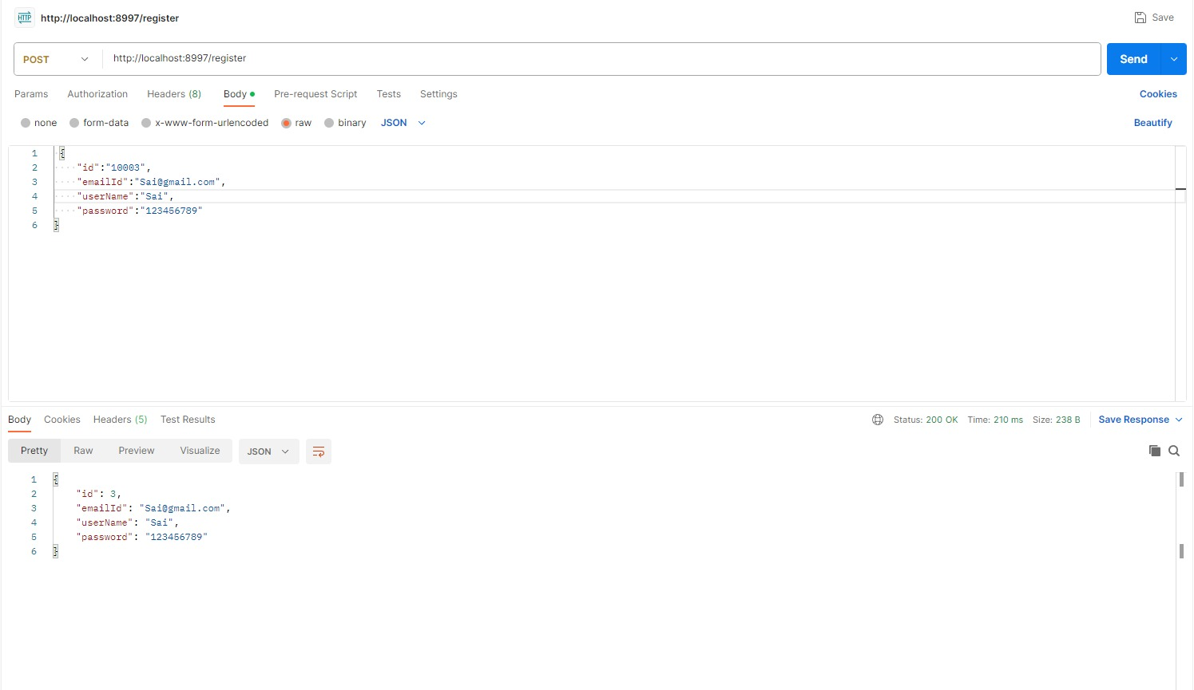
Postman Testing for Admin Controller Service 1. POST Mapping: Here we are Registering the employee.

Slide 21
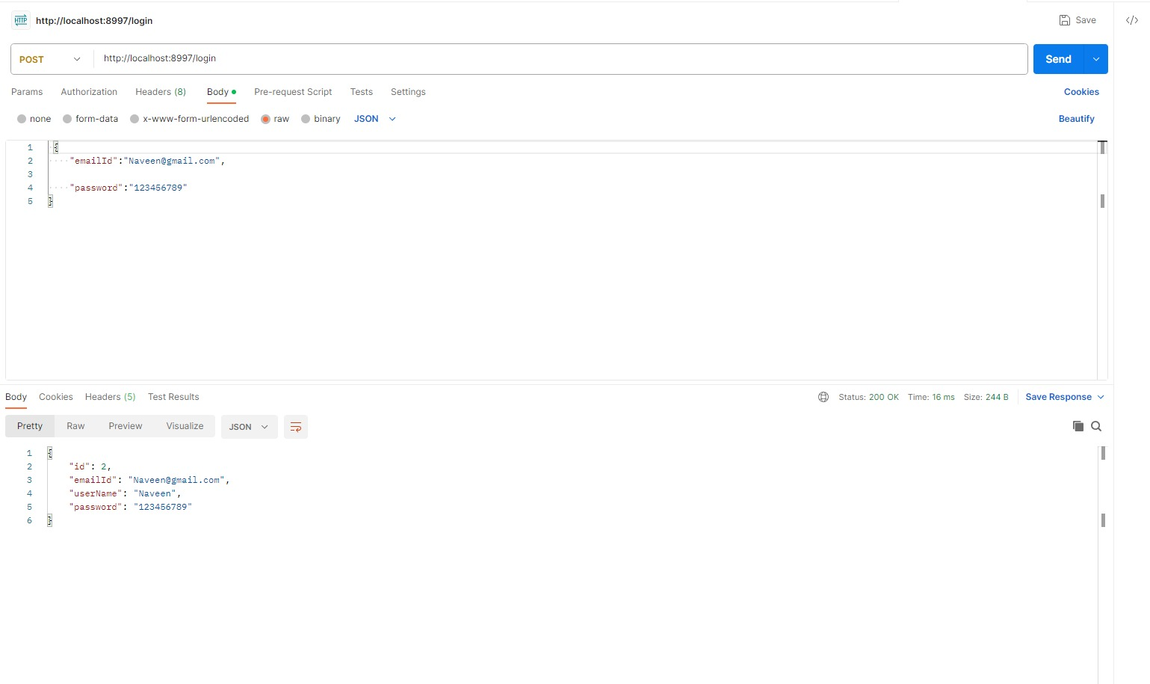
Postman Testing for Admin Controller Service 2. POST Mapping: Here we are providing the Login details of employee.

Slide 22
Vamsi : Admin Controller Service 1. Admin Controller Config Server. 2. Admin Controller Eureka Server. 3. Admin Controller Feign,Resilience 4J,Retry 4. Admin Controller Service.

Slide 23
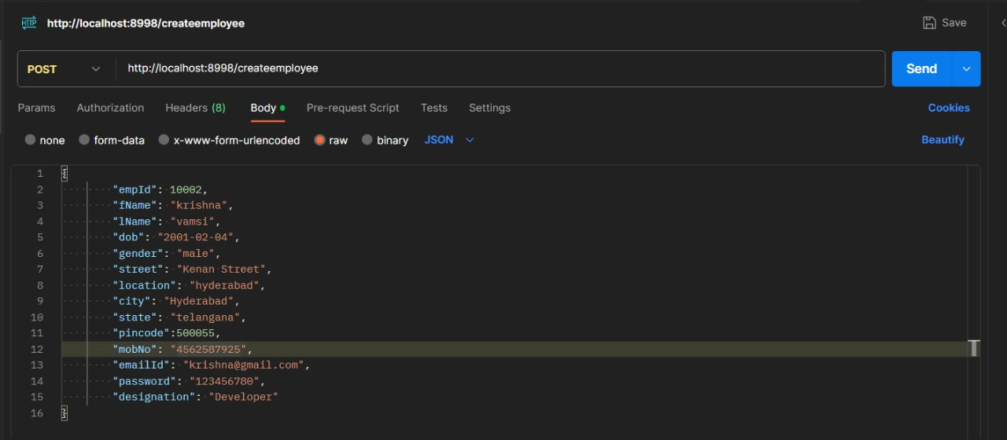
Postman Testing for Admin Controller Service 1. POST Mapping: Here we are providing the data of employee to create a record of employee.

Slide 24
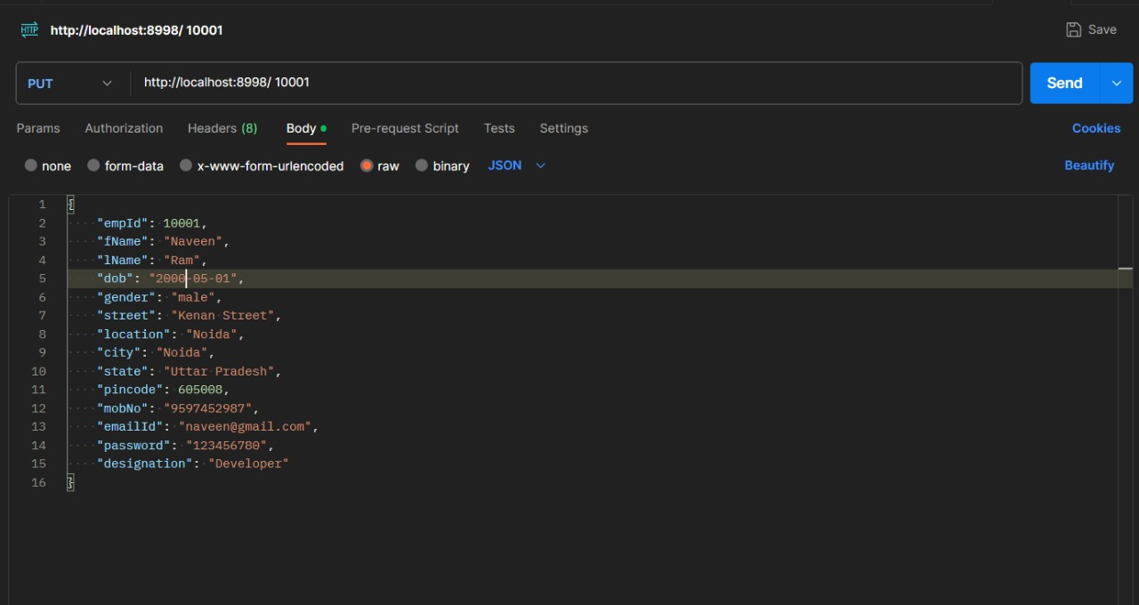
Postman Testing for Admin Controller Service 2. PUT Mapping: Here we are editing the data of employee with empid=10001

Slide 25
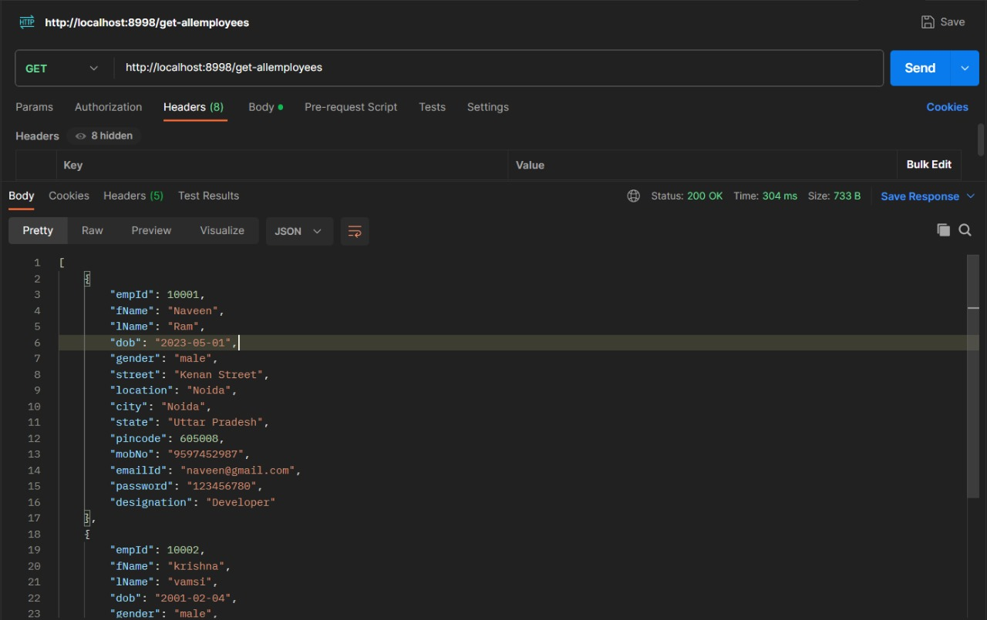
Postman Testing for Admin Controller Service 3. GET Mapping: Here we are fetching the data of all the employees.

Slide 26
Postman Testing for Admin Controller Service 4. GET Mapping: Here we are fetching the data of all the employees.

Slide 27
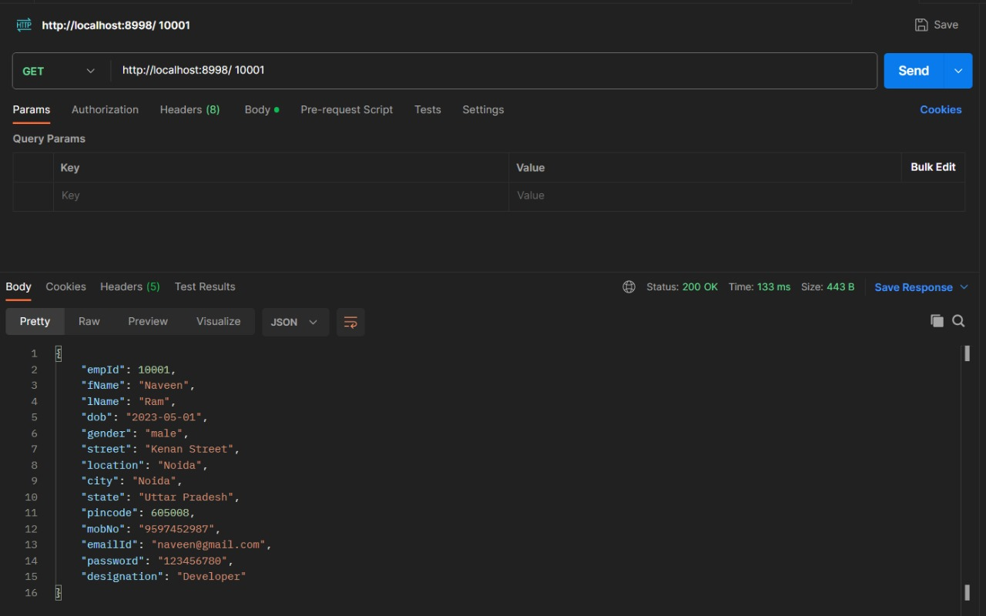
Postman Testing for Admin Controller Service 5. GET Mapping: Here we are fetching the data of all the employee with empid=10001.

Slide 28

Chandini & Sonali :(Attendance) 1. Attendance Controller Config Server. 2. Attendance Controller Eureka Server. 3. Attendance Controller Feign,Resilience 4J,Retry 4. Attendance Controller Service.

Slide 29
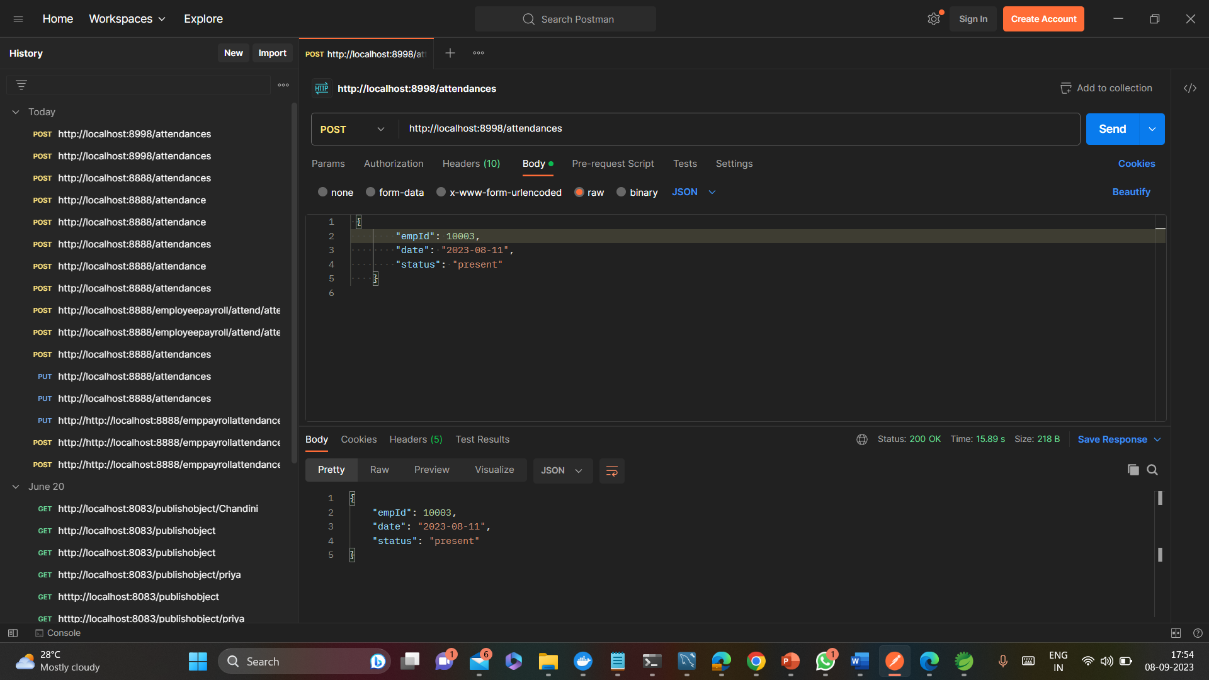
Postman Testing for Attendance Controller Service
POST Mapping:
Here we are passing the data of employee applying for attendance.

Slide 30
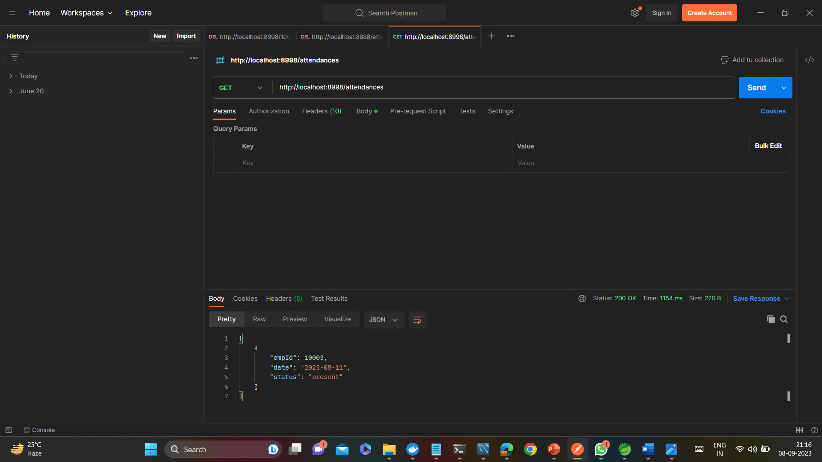
2. GET Mapping: Here we are retrieving the data of employee applied for attendance for a specific employee id ( i.e 10003).

Slide 31
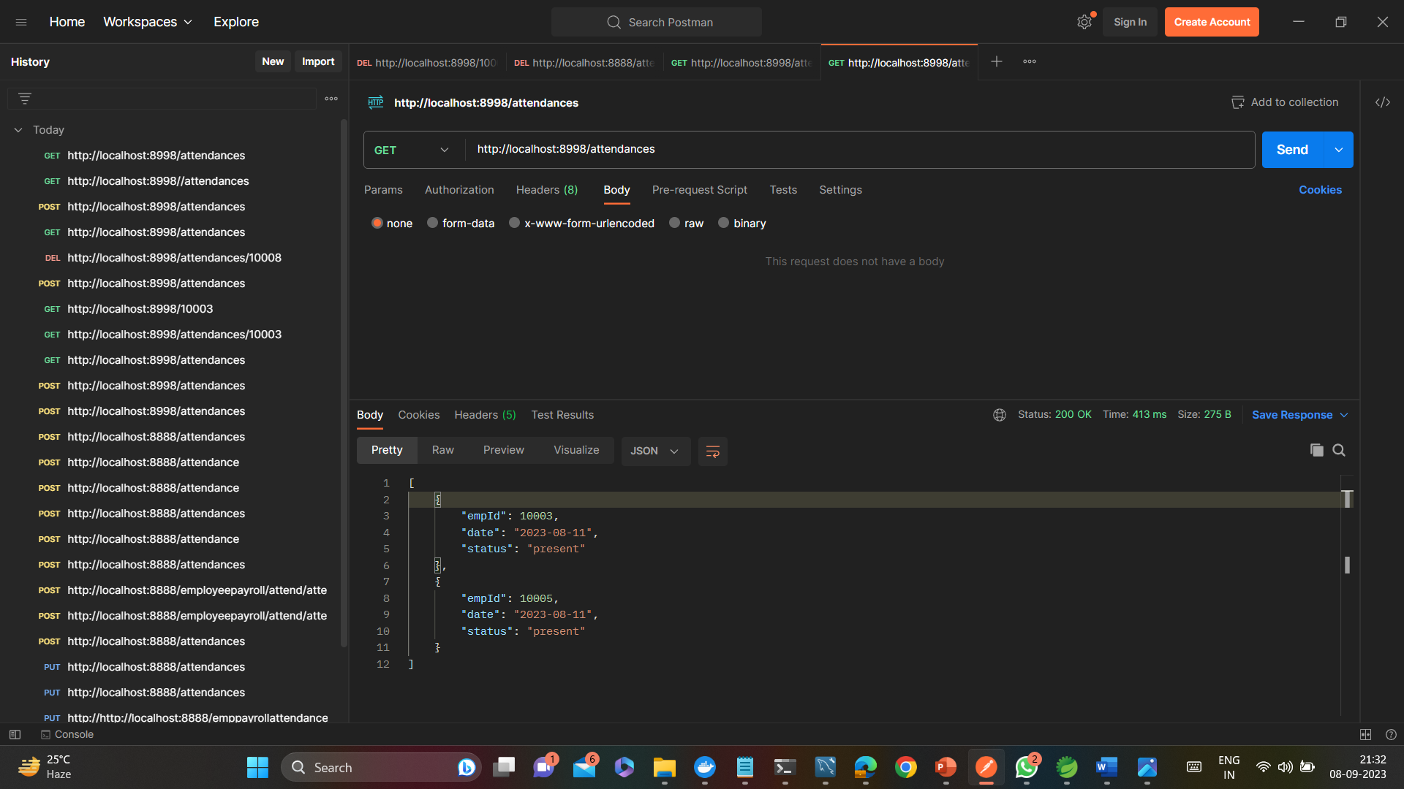
3. GET Mapping:
Here we are fetching the attendance data of all the employees.

Slide 32
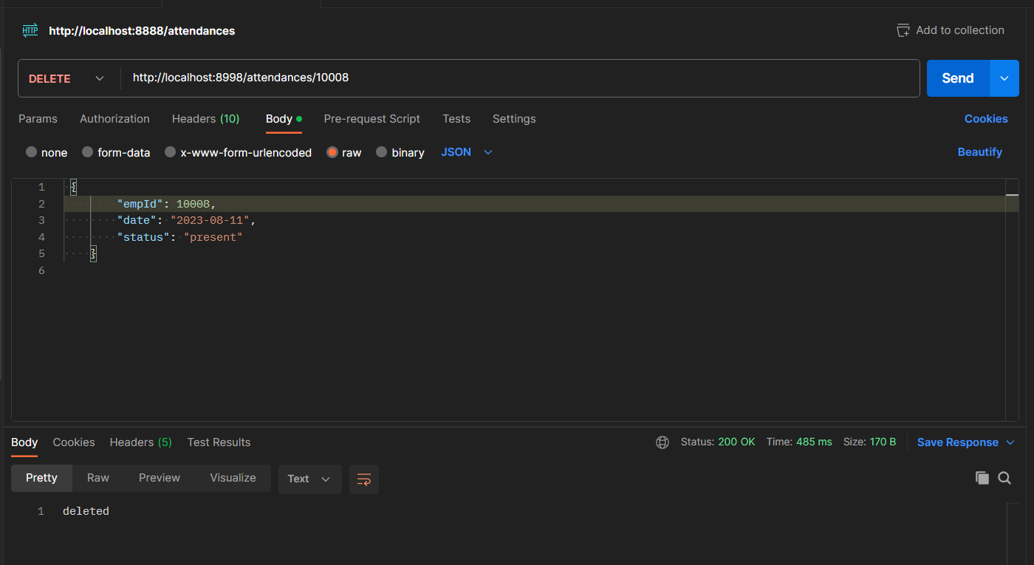
4. DELETE Mapping:
Here we are Deleting the data of the employee with empid = 10008

Slide 33

Mansi : Leave Controller Service 1. Leave Controller Config Server. 2. Leave Controller Eureka Server. 3. Leave Controller Feign,Resilience 4J,Retry 4. Leave Controller Service.

Slide 34
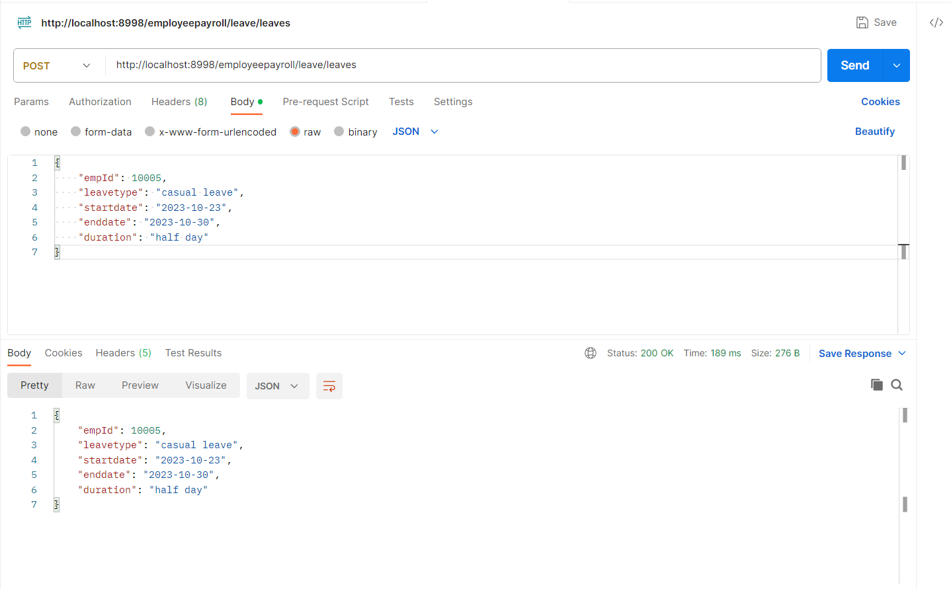
Postman Testing for Leave Controller Service 1. POST Mapping: Here we are passing the data of employee applying for leave.

Slide 35
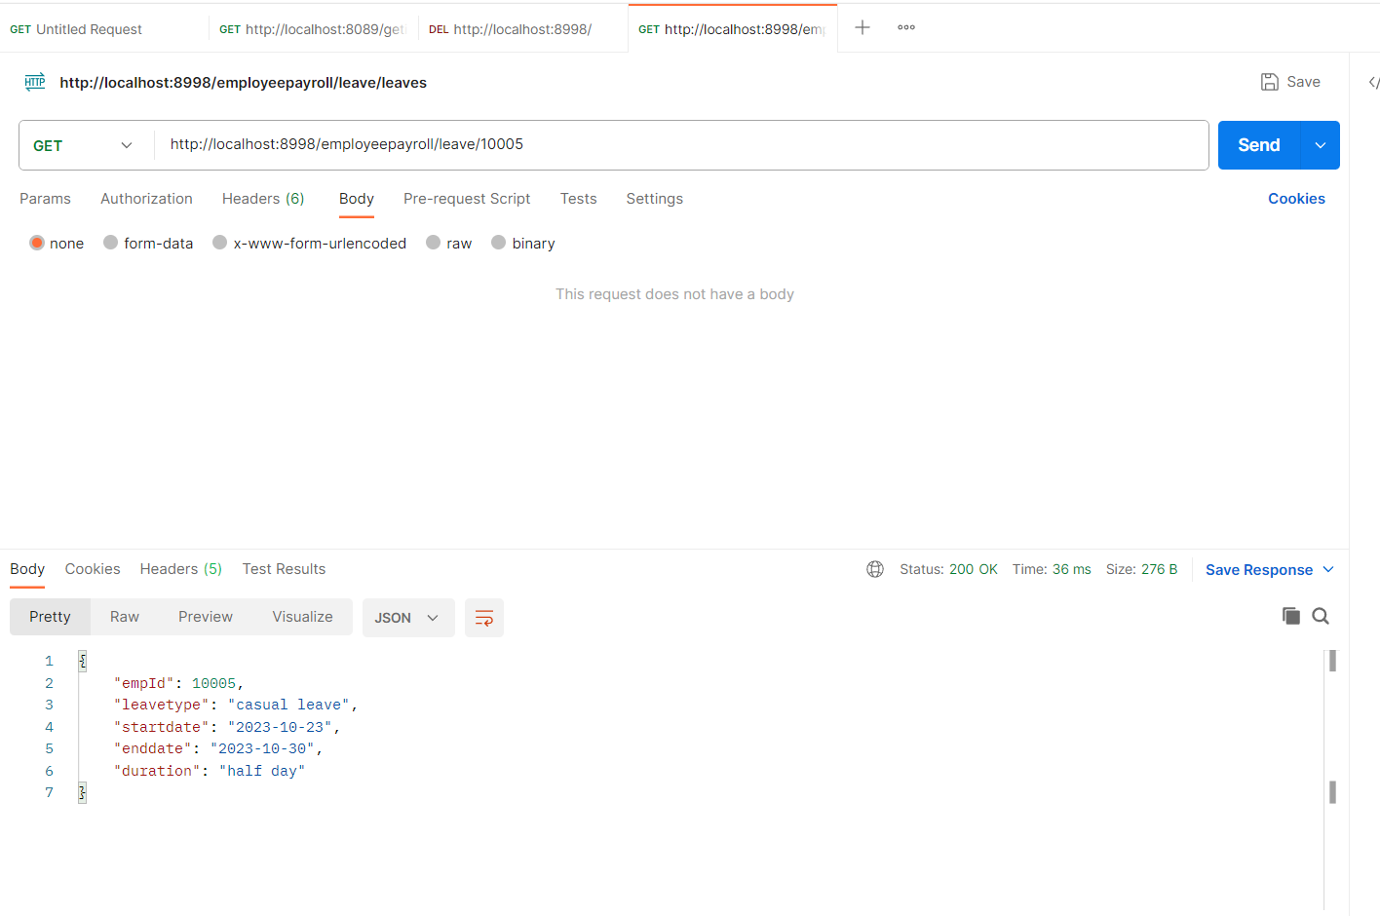
Postman Testing for Leave Controller Service 2. GET Mapping: Here we are retrieving the data of employee applied for leave for a specific employee id ( i.e 10005).

Slide 36
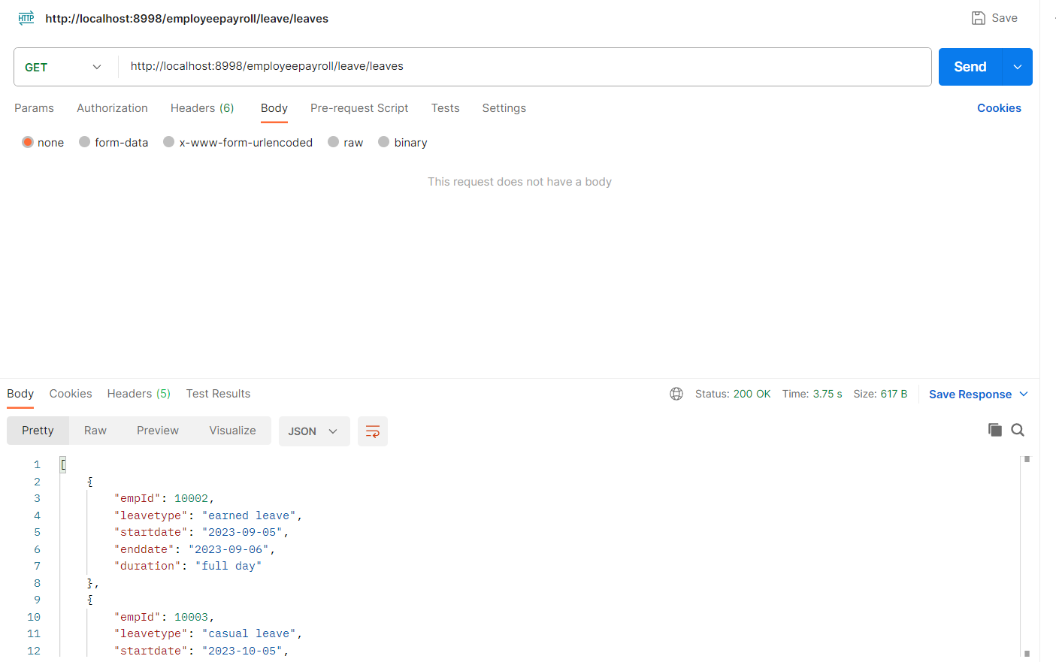
Postman Testing for Leave Controller Service 3. GET Mapping: Here we are retrieving the data of all the employee who applied for leave.

Slide 37
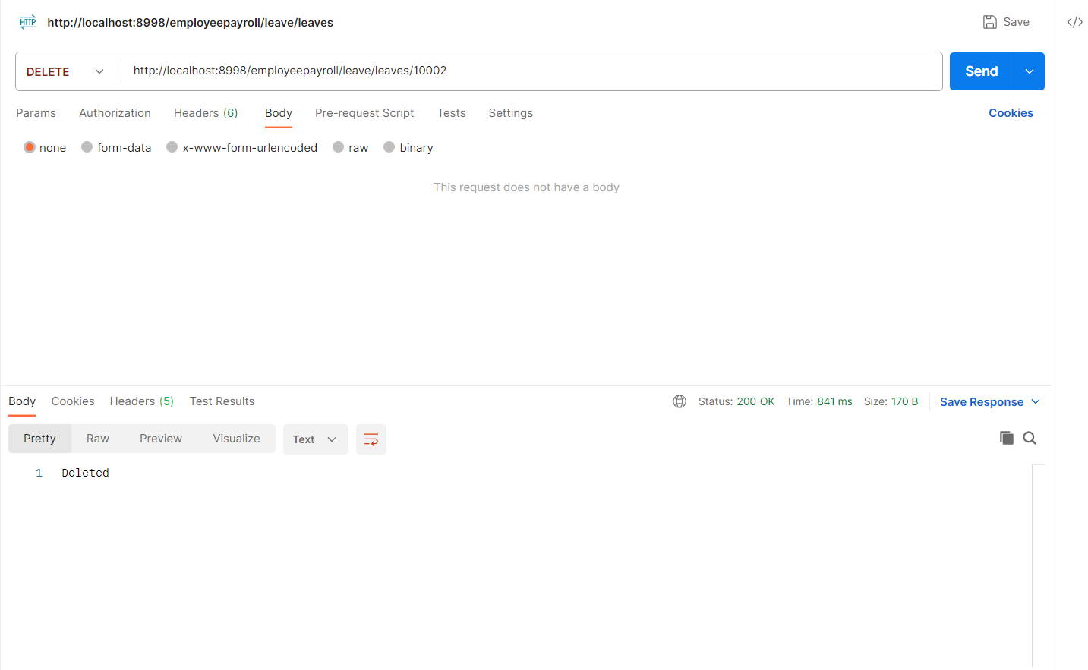
Postman Testing for Leave Controller Service 4. DELETE Mapping: Here we are Deleting the data of the employee with empid = 1002.

Slide 38

Prabhakaran: Schedule controller 1.Schedule controller config server. 2.Schedule controller Eureka server. 3.Schedule controller Feign,Resilience 4J,Retry 4.Schedule controller service.

Slide 39
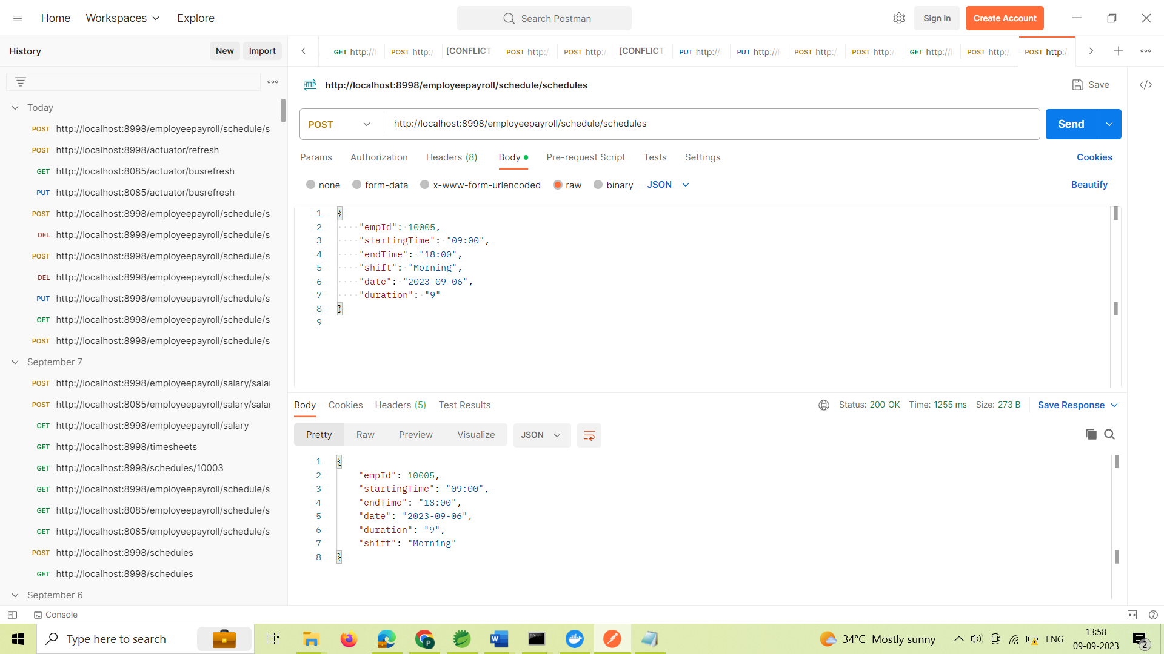
Postman Testing for Schedule Controller Service 1.POST Mapping:

Slide 40

Postman Testing for Schedule Controller Service 2. GET Mapping:

Slide 41
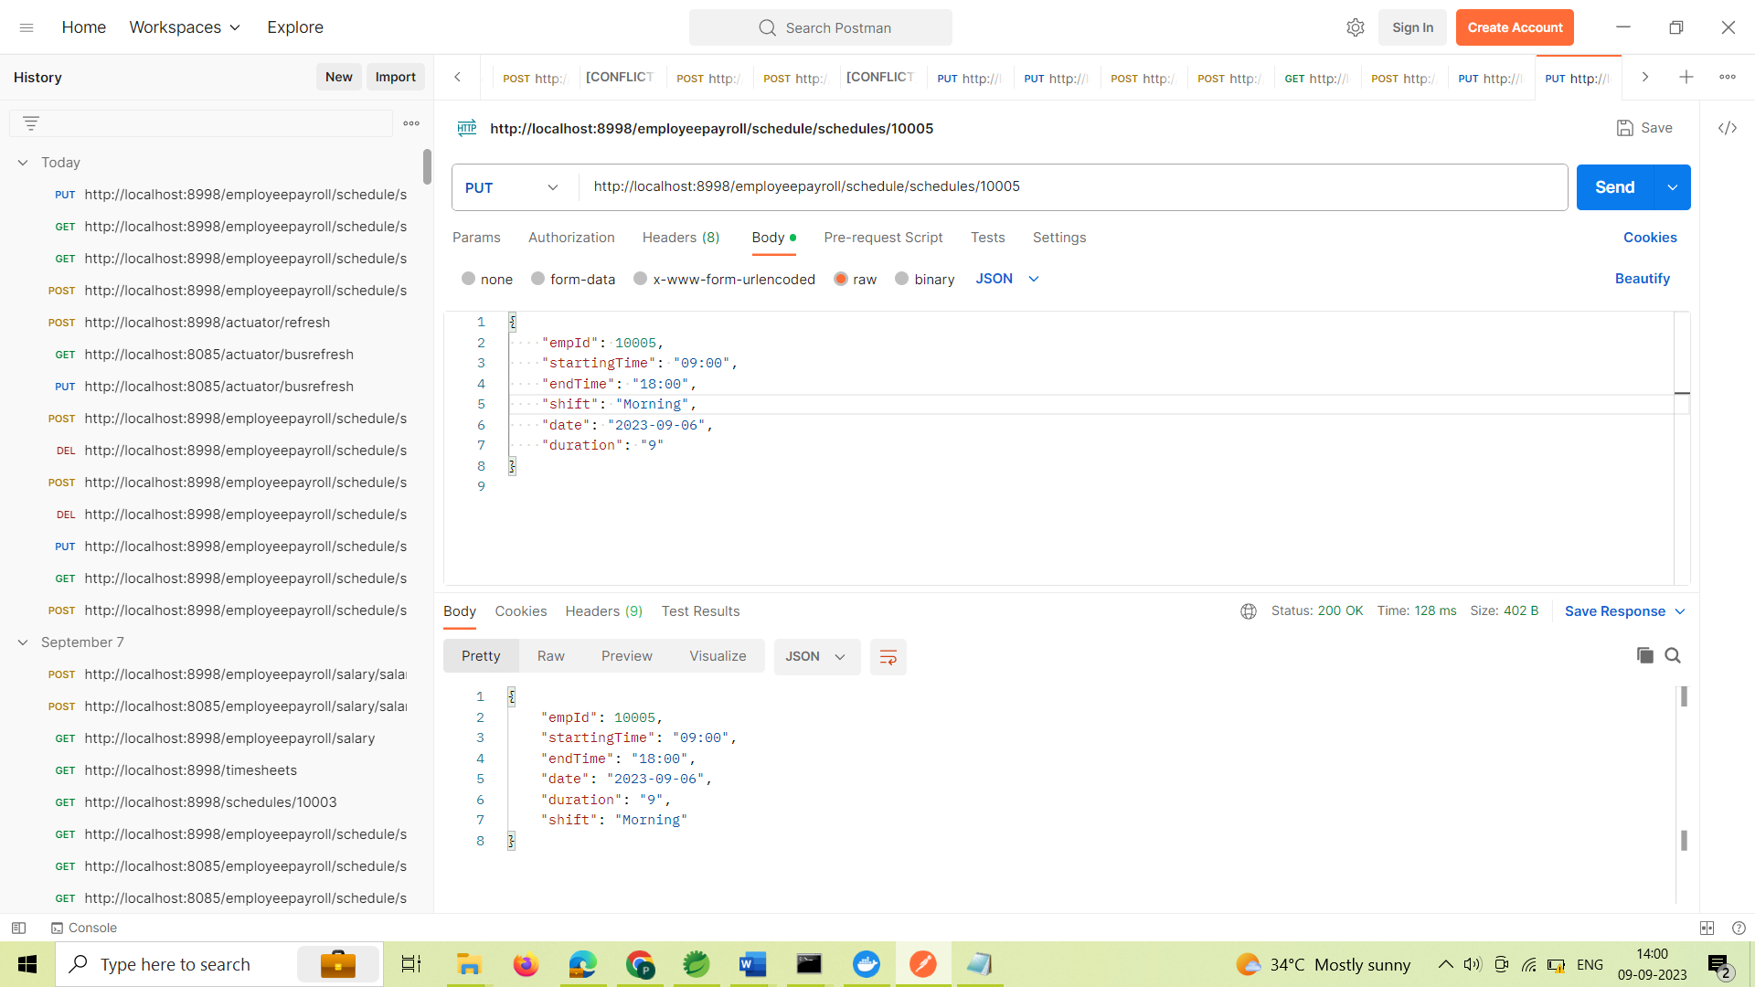
Postman Testing for Schedule Controller Service 3. PUT Mapping:

Slide 42

Postman Testing for Schedule Controller Service 4. DELETE Mapping:

Slide 43

Varshitha: Salary controller 1.Salary controller config server 2.Salary controller Eureka sever 3.Salary controller Feign,Resilience 4J,Retry 4.Salary controller service

Slide 44
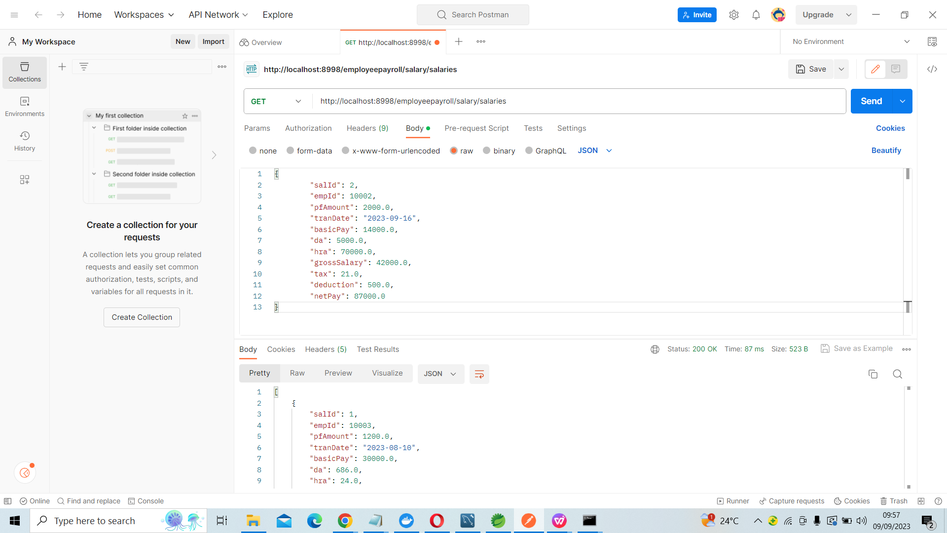
Postman Testing for Salary Controller Service 1.GET Mapping:

Slide 45
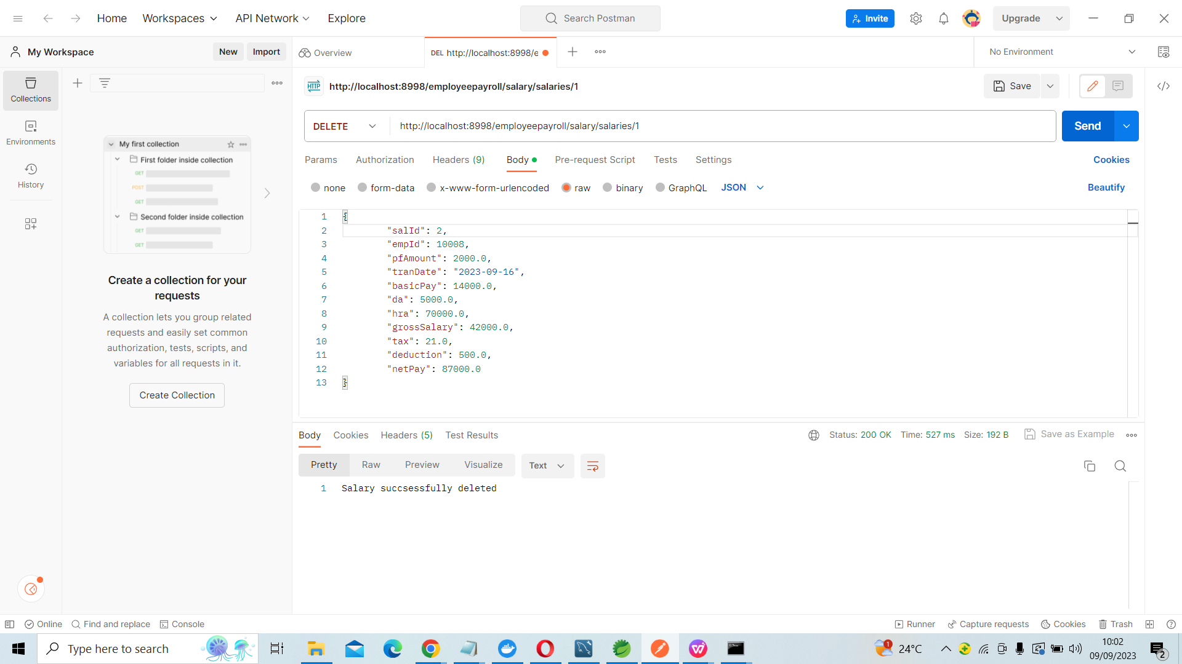
Postman Testing for Salary Controller Service 2.DELETE Mapping:

Slide 46
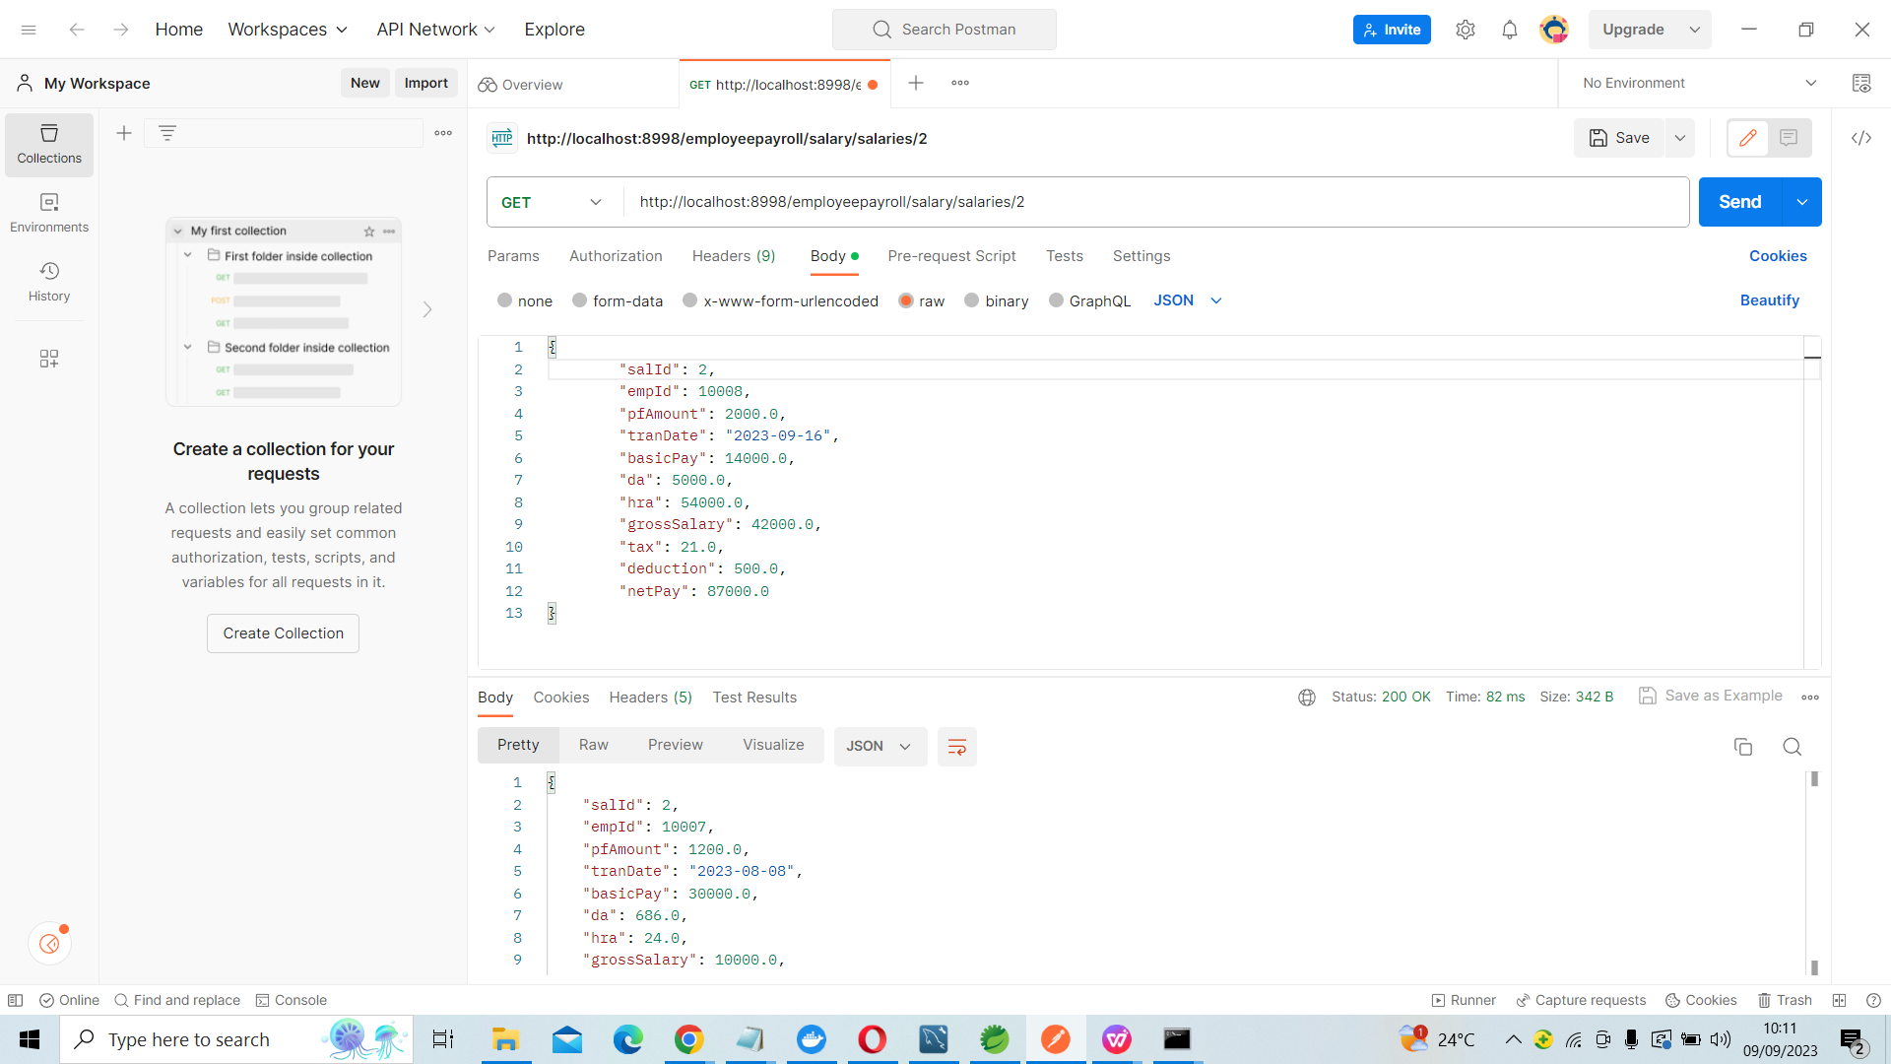
Postman Testing for Salary Controller Service 3.GET By ID Mapping:

Slide 47
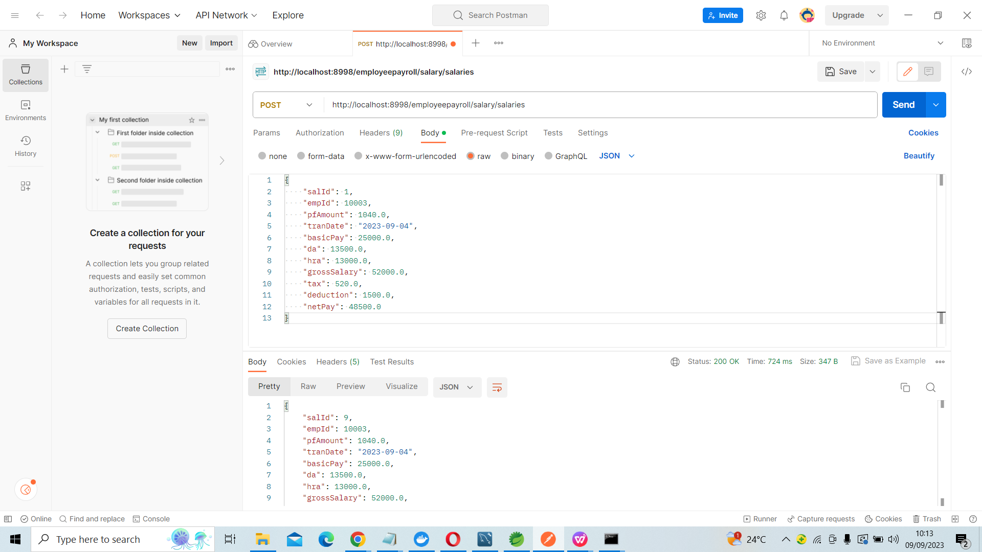
Postman Testing for Salary Controller Service 4.POST Mapping:

Slide 48
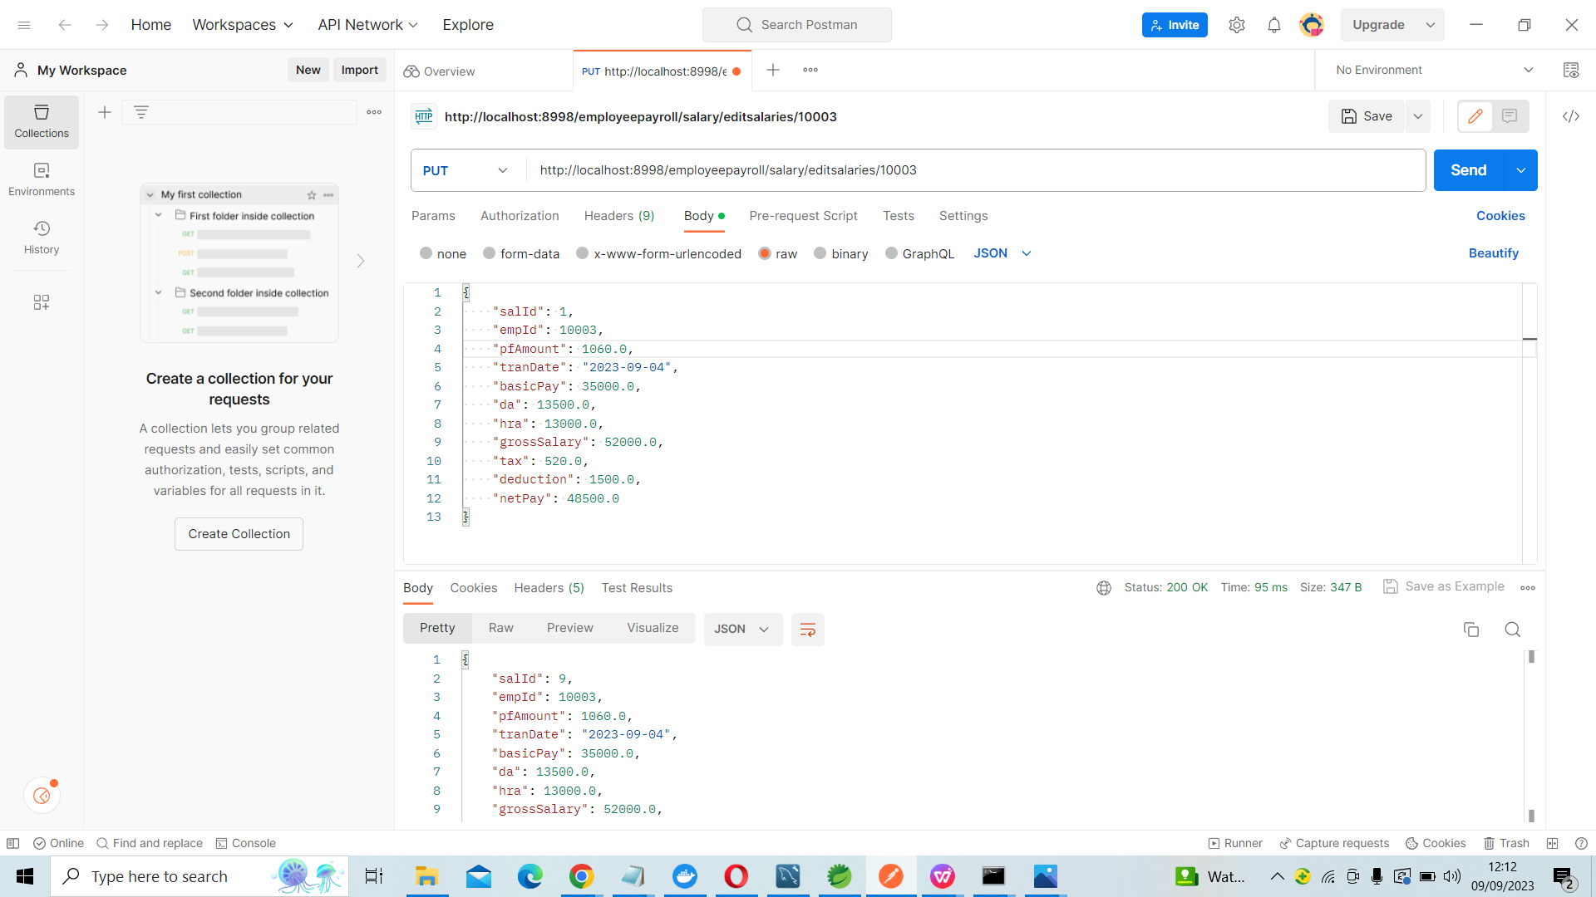
Postman Testing for Salary Controller Service 5.PUT Mapping:

Slide 49

Vasanth: Timesheet Service 1.Timesheet config sever. 2.Timesheet Eureka server. 3.Timesheet Feign,Resilience 4J,Retry 4.Timesheet service

Slide 50
Postman Testing for Timesheet Controller Service 1.GET Mapping:

Slide 51
Postman Testing for Timesheet Controller Service 2.GET Mapping:

Slide 52
Postman Testing for Timesheet Controller Service 3.POST Mapping:

Slide 53
Postman Testing for Timesheet Controller Service 4.PUT Mapping:

Slide 54
Postman Testing for Timesheet Controller Service 5.DELETE Mapping:

Slide 55

Girish: Employee Controller 1.Employee controller Config server 2.Employee Controller Eureka Server 3.Employee Controller Feign,Resilience 4J,Retry 4.Employee Controller Service

Slide 56
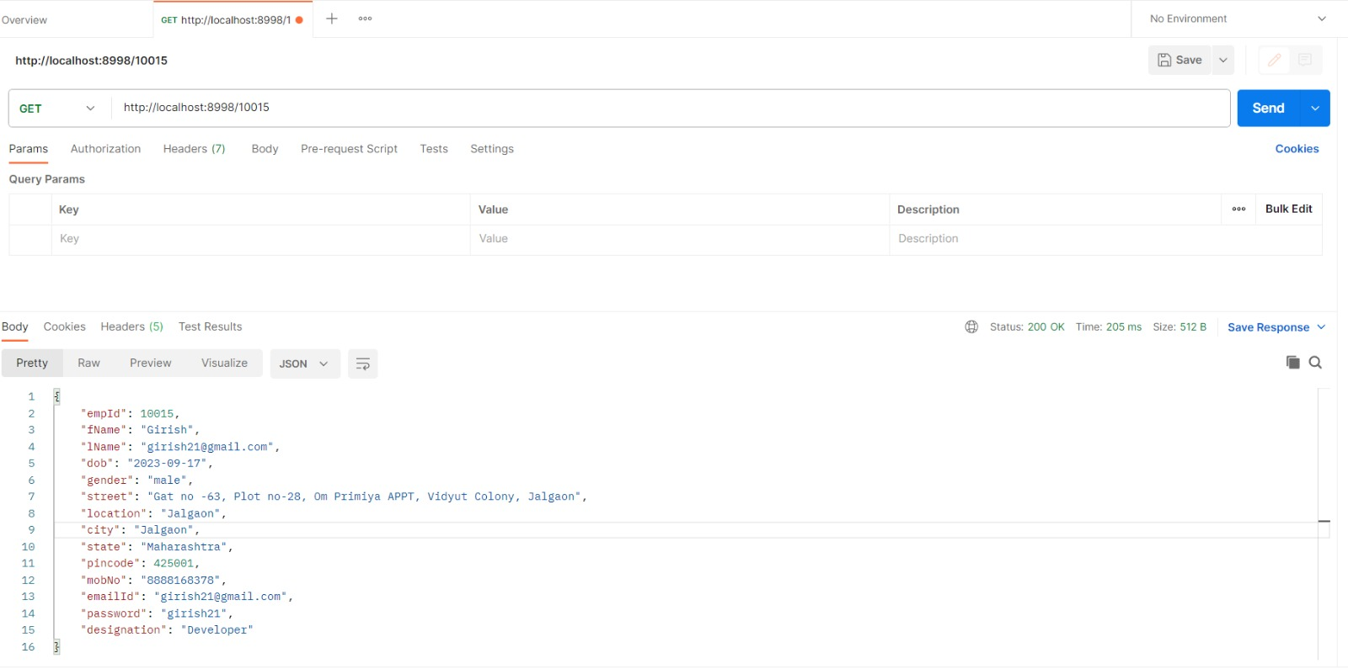
Postman Testing for Employee Controller Service 1.GET Mapping:

Slide 57

Raju: Registration controller 1.Registration controller Config server 2.Registration controller Eureka server 3.Registration controller Feign,Resilience 4J,Retry 4.Registration controller Service

Slide 58
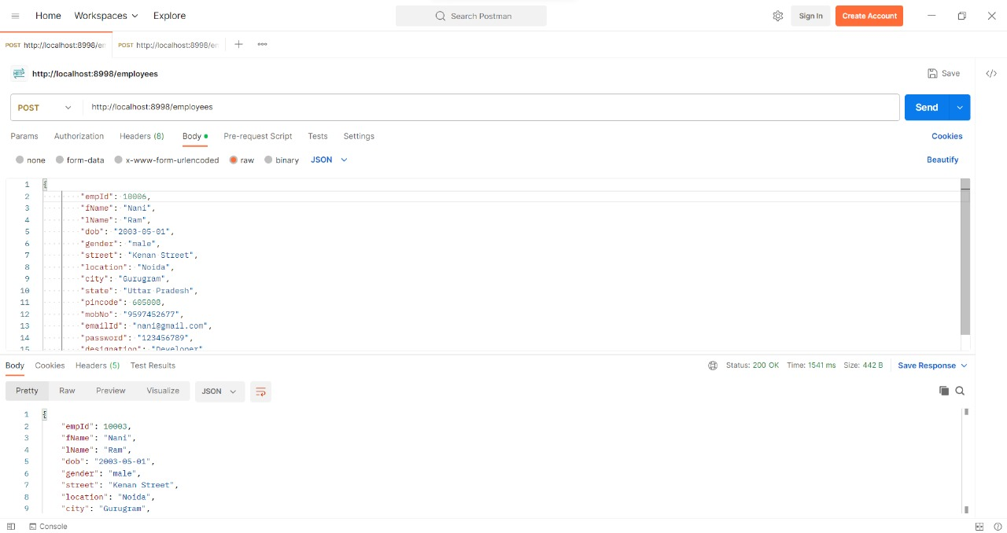
Postman Testing for Registration Controller Service 1.POST Mapping:(Employee registration)

Slide 59
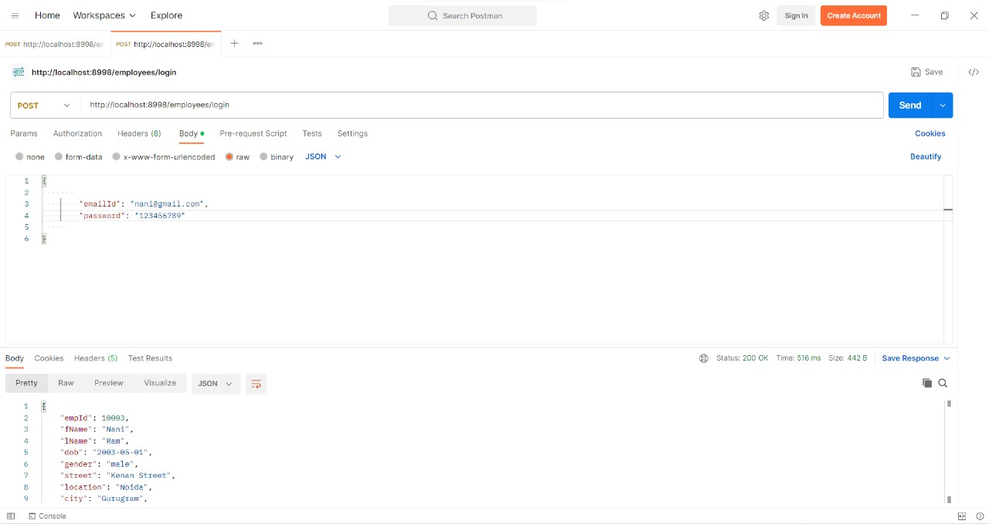
Postman Testing for Registration Controller Service 2.POST Mapping:(Employee Login)

Slide 60
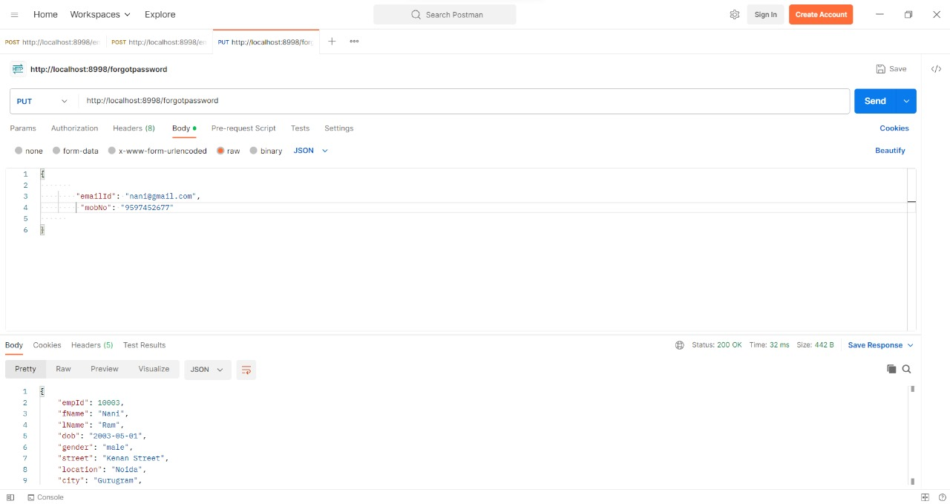
Postman Testing for Registration Controller Service 3.PUT Mapping:

Slide 61
Employee APIs
HTTP methods | URL | Operation
GET | http://localhost:8998/10015 | To retrieve all the employees

Slide 62
Admin APIs
HTTP methods | URL | Operation
GET | http://localhost:8998/get-allemployees | To get the admin list of particular employee
PUT | http://localhost:8998/ 10001 | To update the admin list of all the employees
POST | http://localhost:8998/createemployee | To create the admin list of particular employee
DELETE | http://localhost:8998/ 10002 | To delete the admin list of particular employee

Slide 63
Registration APIs
HTTP methods | URL | Operation
POST | http://localhost:8998/employees | To create the employee list of particular employee
PUT | http://localhost:8998/forgotpassword | used for forgot password
POST | http://localhost:8998/employees/login | used for employee login

Slide 64
Attendance APIs
HTTP methods | URL | Operation
GET | http://localhost:8998/10003 | To get the attendance of particular employee
GET | http://localhost:8998/attendances | To get the attendances of all the employees
POST | http://localhost:8998/attendances | To create the attendance of particular employee
DELETE | http://localhost:8998/attendances/10008 | To delete the attendance of particular employee

Slide 65
Leave APIs
HTTP methods | URL | Operation
GET | http//localhost:8998/employeepayroll/leave/10005 | To get the leave list of particular employee with id number 10005
GET | http//localhost:8998/employeepayroll/leave/leaves | To get the leave list of all the employees
POST | http//localhost:8998/employeepayroll/leave/leaves | To create the leave list of particular employee
DELETE | http//localhost:8998/employeepayroll/leave/leaves/10002 | To delete the leave list of particular employee with employee id 10002

Slide 66
Schedule APIs
HTTP methods | URL | Operation
GET ALL | http://localhost:8998/employeepayroll/schedule/schedules | To get the work schedule of particular employee
GET BY ID | http://localhost:8998/employeepayroll/schedule/schedules/10005 | To get the Work schedule of all the employees
POST | http://localhost:8998/employeepayroll/schedule/schedules | To create the Work schedule of particular employee
DELETE | http://localhost:8998/employeepayroll/schedule/schedules/10005 | To delete the Work schedule of particular employee
PUT | http://localhost:8998/employeepayroll/schedule/schedules/10005 | To update the Work schedule of particular employee

Slide 67
Salary list APIs
HTTP methods | URL | Operation
GET | http://localhost:8998/employeepayroll/salary/salaries | To get the salary list of particular employee
DELETE | http://localhost:8998/employeepayroll/salary/salaries/1 | To delete the salary sheet for particular employee
GET | http://localhost:8998/employeepayroll/salary/salaries/2 | To get the salary list by salary id
POST | http://localhost:8998/employeepayroll/salary/salaries | To create the salary list for particular employee
PUT | http://localhost:8998/employeepayroll/salary/editsalaries/10003 | To update the salary sheet for particular employee

Slide 68
Timesheet APIs
HTTP methods | URL | Operation
GET | http://localhost:8998/get-emp/10001 | To get the timesheet of particular employee by id
DELETE | http://localhost:8998/timesheets/10002 | To delete the timesheet for particular employee
GET | http://localhost:8998/timesheets | To get the timesheet of employee
POST | http://localhost:8998/timesheets | To create the timesheet for particular employee
PUT | http://localhost:8998/timesheets/10003 | To update the timesheet for particular employee

Slide 69


Slide 70

ADVANTAGES
Modularity with Spring Boot
Service Discovery
Load Balancing
Centralized Configuration
Circuit Breaker Pattern
Distributed Tracing

Slide 71
Conclusion:
“Employee Payroll Management System” is developed to achieve maximum efficiency and reduce the time taken to handle the Payroll activity.
Spring Cloud is a robust and versatile framework that simplifies the development and management of microservices, offering a comprehensive set of tools and features to enhance the scalability, resilience, and agility of modern applications.

Slide 72

THANK YOU !

